Slide 1
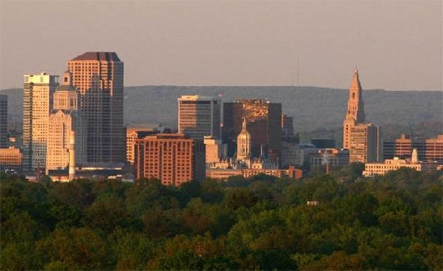
Talking Buildings of Hartford
By: Melissa Thom and Renzulli Academy 4th Graders

Slide 2
Type I
Experiences
Type 2
Skills
Local historians and experts
Primary
Sources
Team
Work
Authentic audiences

Slide 3
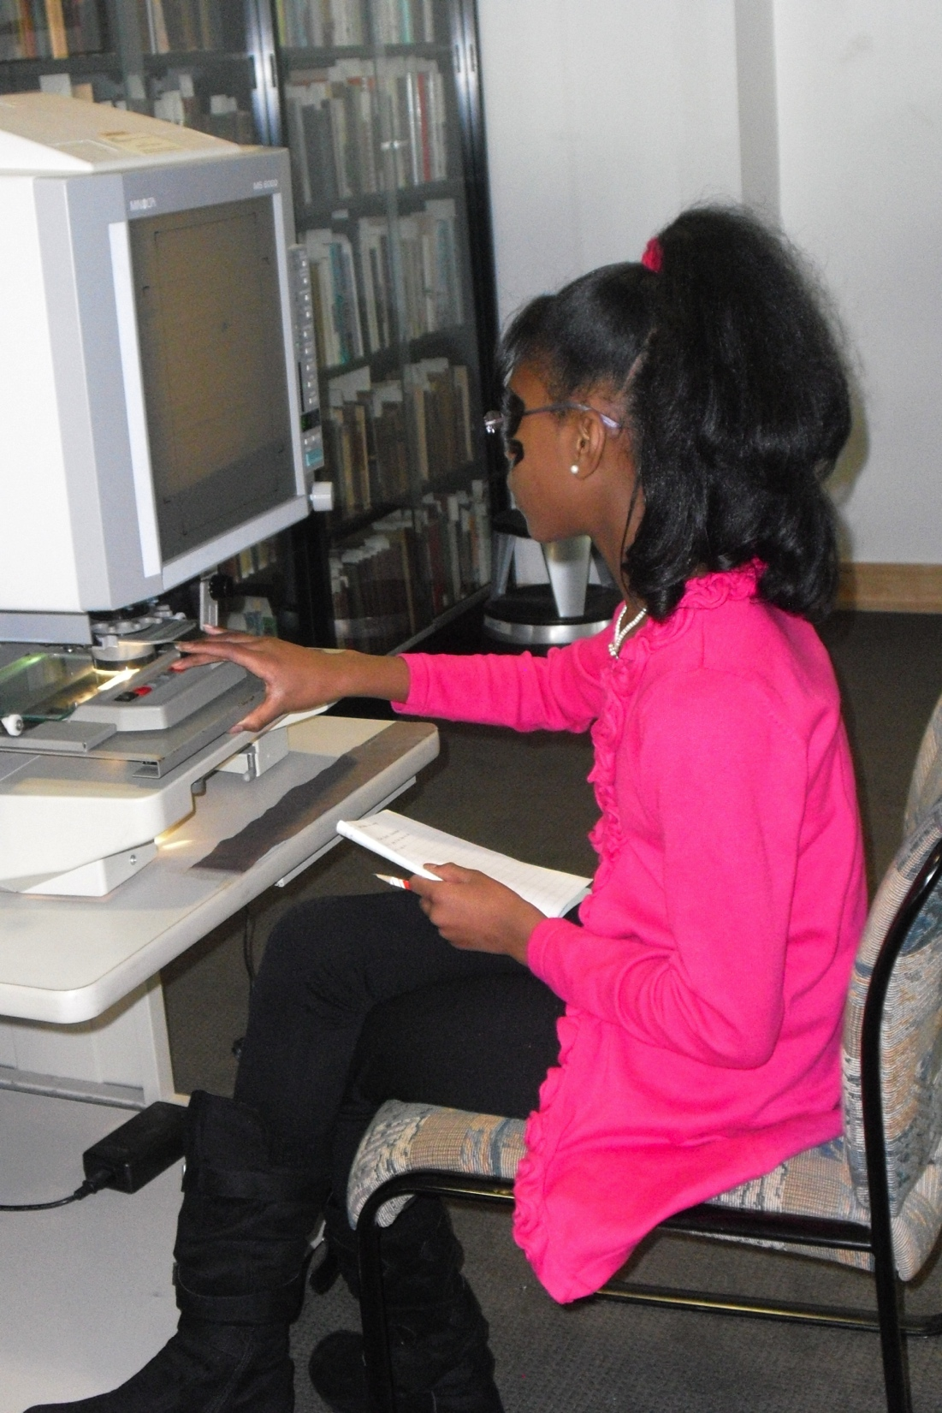
Student Products
Notes:
Precious’s Presentation: The Capitol Building

Slide 4
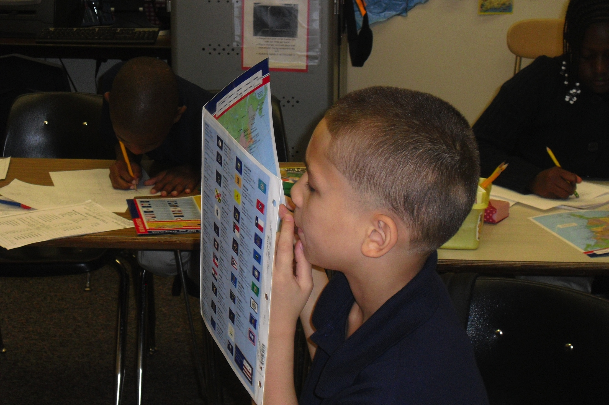
Student Products
Notes:
Precious’s Presentation: The Capitol Building

Slide 5
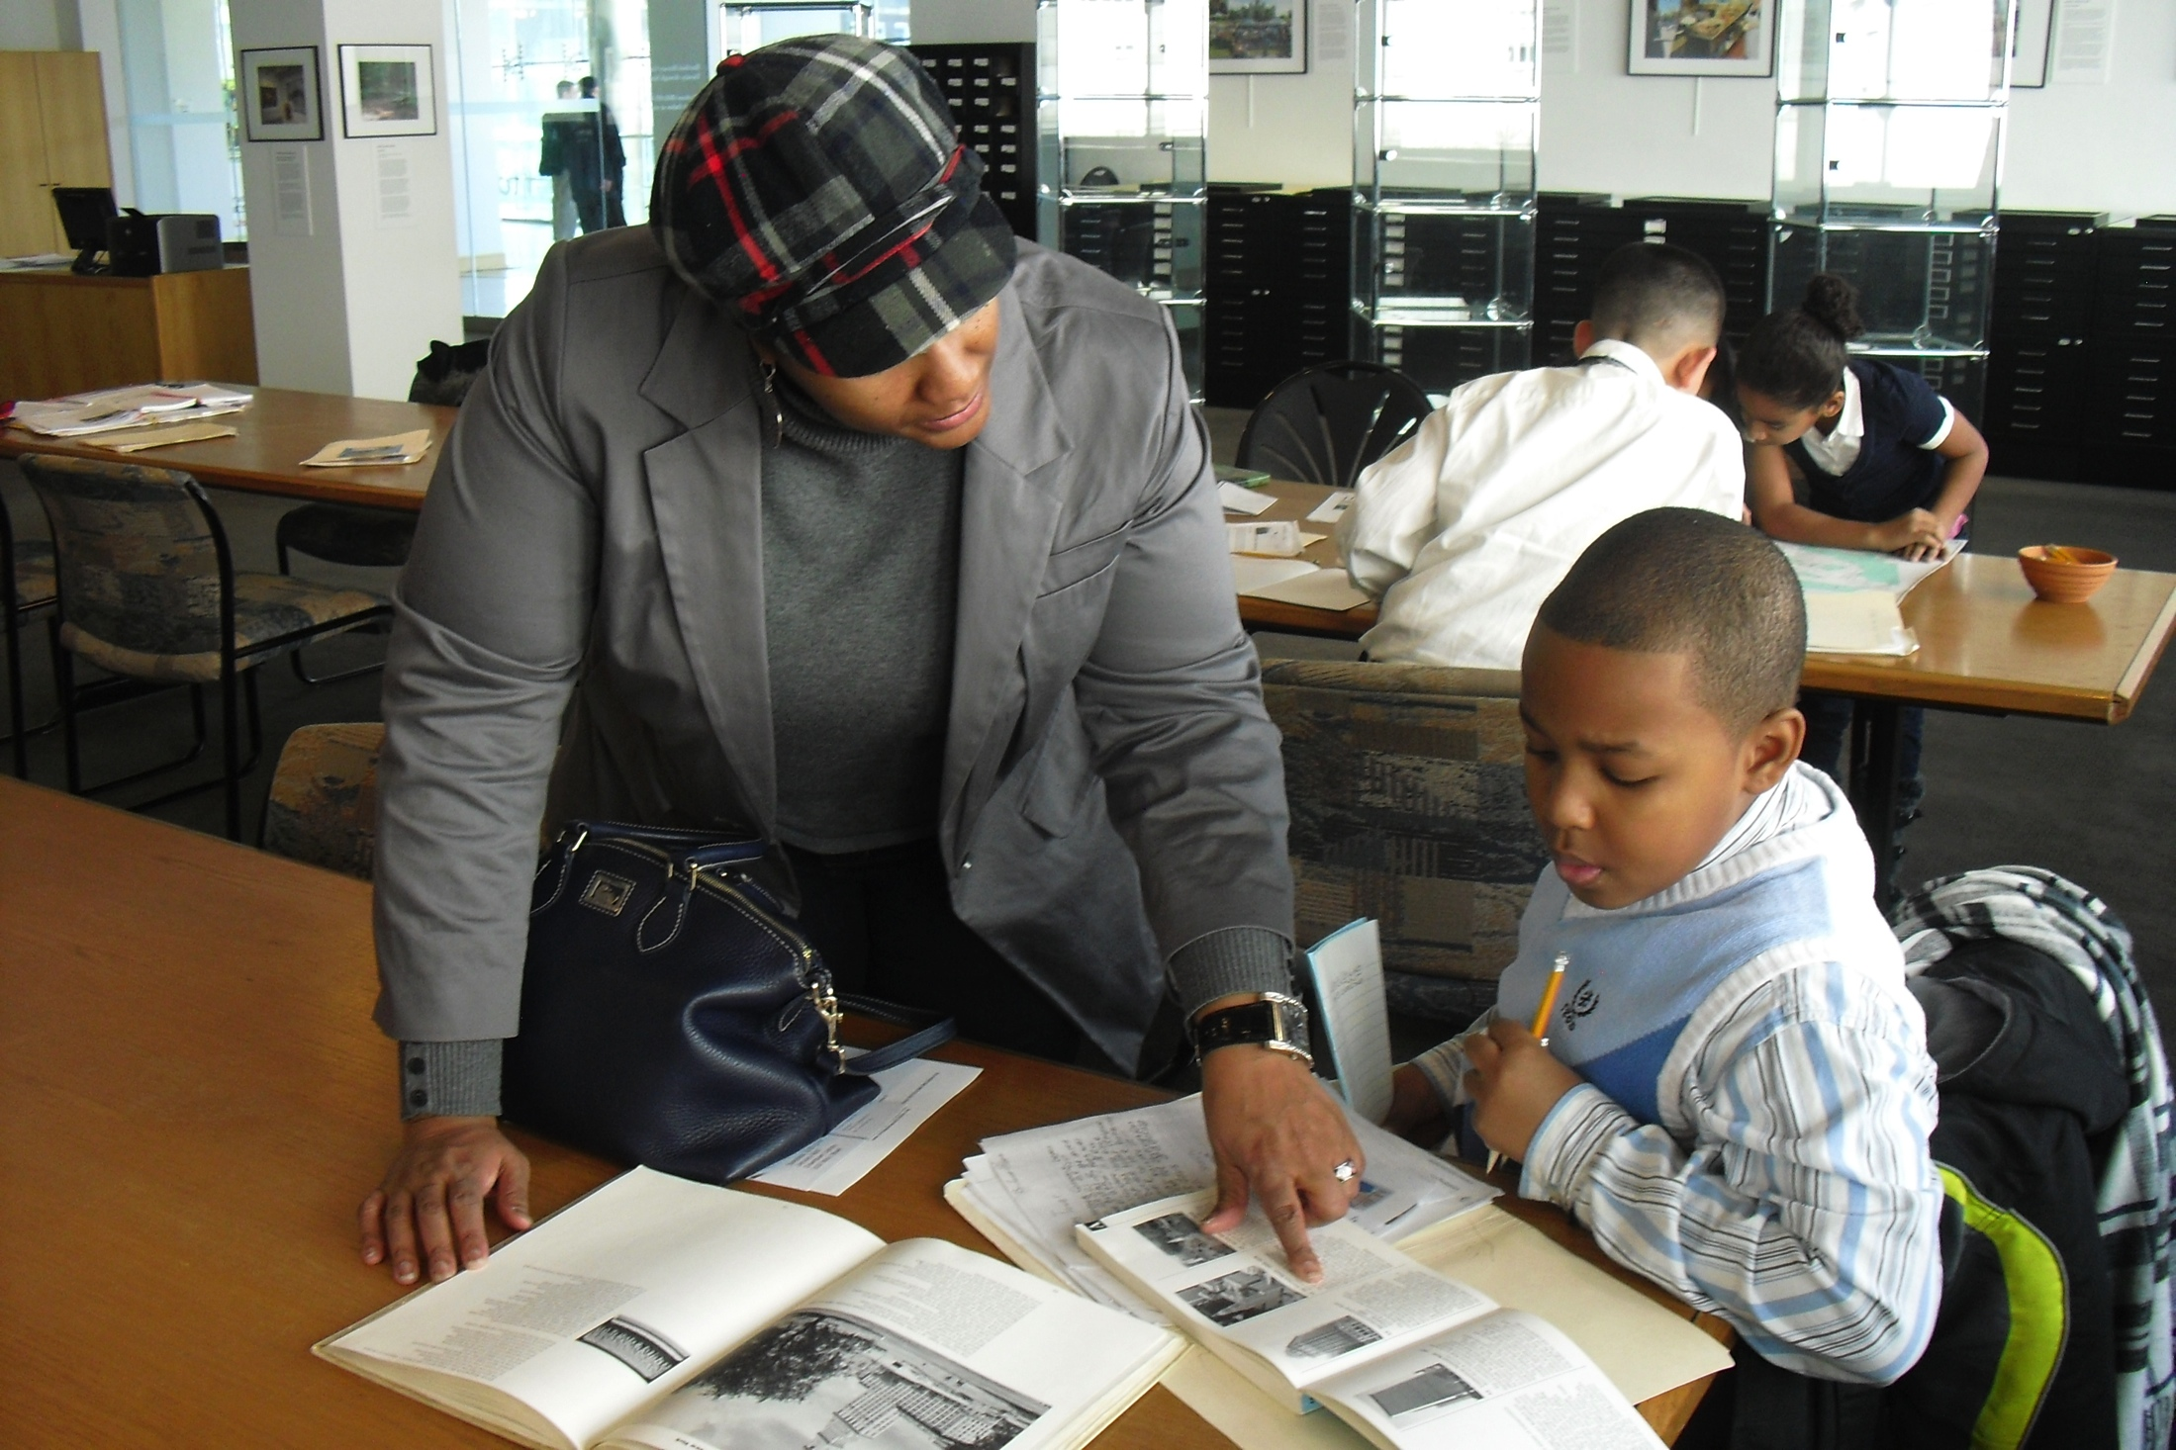
Student Products
Notes:
Precious’s Presentation: The Capitol Building

Slide 6
What are Type 1 Activities for this project?
Field Trips
Guest Speakers
Experts
Exposure to high-interest books and materials
4th Grade students interact with Wilson Faude, a well-known Hartford historian
Notes:
Field trips to
--hartford history center with the center’s curator and a local historian who is very knowledgeable about all things Hartford
--an interest center that contained a variety of books all about the history and architecture of hartford and it’s buildings
--guest speakers from the butler-mccook house to discuss primary sources
--ideas for next time I do the unit: bring in experts in the field of preservation such as someone from the Hartford Preservation Alliance, Jennifer Lanzing from the UCONN Library history dept, someone from the National Register of Historic Places
--field trips to add could include: doing a walking tour of downtown Hartford where students are taking pictures of the buildings, a research trip to the CT state library and archives, a research trip to the Dodds Research Center at UCONN,

Slide 7
What are Type 2 Activities for this project?
Lessons on how to be a historian
Lessons on creating a multimedia product
4th Grade students interact with secondary sources at the Hartford History Center
Notes:
-primary/secondary source: locating, identifying and analyzing them
-how to create interview questions
-how to use the components of a non-fiction book such as table of contents and index
-how to use historical context to make connections and understand history as a story
-how to locate an expert/historian and then send an email
-how to analyze old photographs and use clues to tell the story of the event in the photo
-how to use the various components of a program called Photostory (import images, add transitions, narrate,add music)
-how to generate questions for historical research and then locate sources to answer those questions
-how to use powerpoint to create a slide and save as a JPEG interchange format in order to use as an image in presentation
-how to write a script to help them with a phone interview

Slide 8
What makes this a Type 2.5 instead of a Type III?
Teacher-initiated
4th Grade students interact with a variety of community members including this reporter at the CECA Technology Expo
Notes:
-primary/secondary source: locating, identifying and analyzing them
-how to create interview questions
-how to use the components of a non-fiction book such as table of contents and index
-how to use historical context to make connections and understand history as a story
-how to locate an expert/historian and then send an email
-how to analyze old photographs and use clues to tell the story of the event in the photo
-how to use the various components of a program called Photostory (import images, add transitions, narrate,add music)
-how to generate questions for historical research and then locate sources to answer those questions
-how to use powerpoint to create a slide and save as a JPEG interchange format in order to use as an image in presentation
-how to write a script to help them with a phone interview

Slide 9
How was this a Type III for ME??

